Slide 1
VIA PASSANA
Daniela Koch
Matej Michalek
Michaela Golhova
Michal Karol Pompa
Remedios Pastor Molines

Slide 2
Agenda
Introduction
Analysis
Design
Implementation
Process
Conclusion

Slide 3



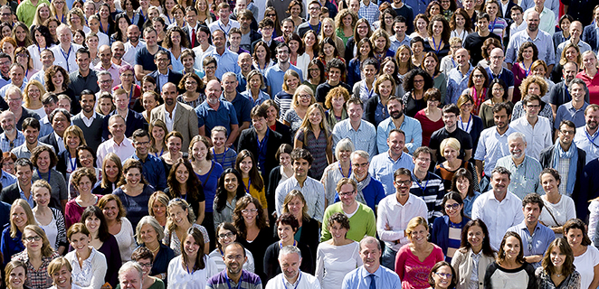
Introduction

Slide 4



Introduction
US
VIA

Slide 5


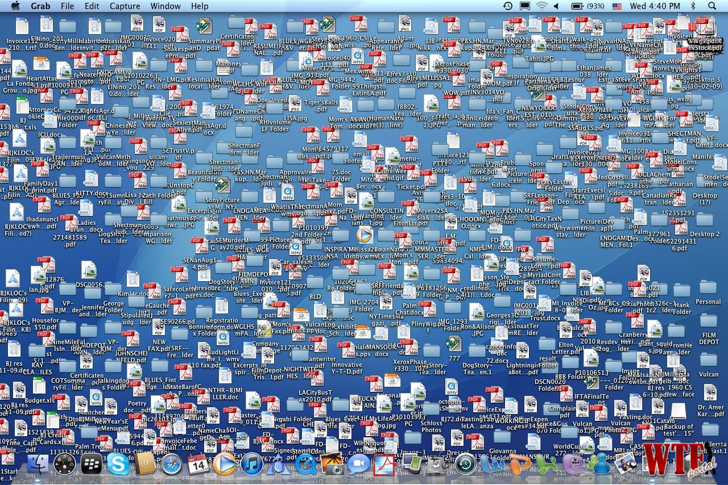


Slide 6


Slide 7

Problem statement
How to store data about events, members and lecturers?

Slide 8

Problem statement
How to find proper lecturers for events ?

Slide 9

Problem statement
How to make the system easy to extend and provide new functionalities?

Slide 10






Delimitations
FEEDBACK

Slide 11
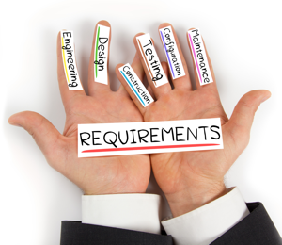

Slide 12




Functional requirements
Members/Participants
Lecturer
Event
Newsletter

Slide 13
Member/Participant
Store info about new member
Generate list of emails of members who have not paid
Count the price for members, having considered the discount for events
Sign up member/participant to an event

Slide 14
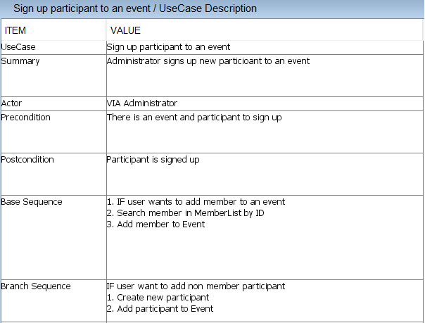

Slide 15
Lecturer
Store info about new lecturer
Search for lecturers of given category

Slide 16
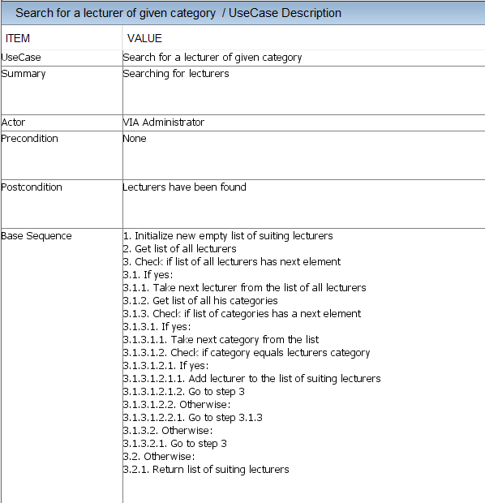

Slide 17
Event
Plan and modify event
Search for not finalized events
Return the amount of available places for every event

Slide 18
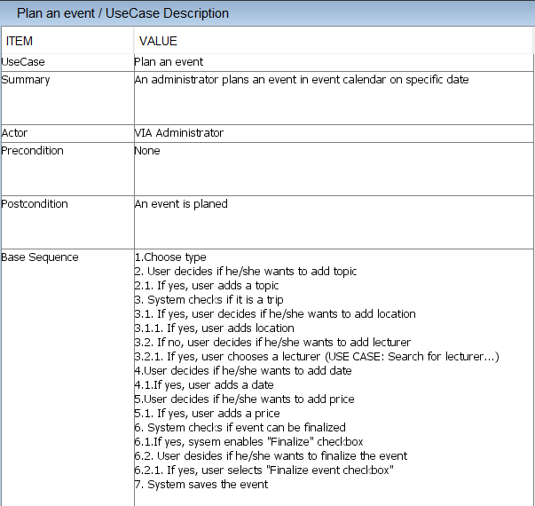

Slide 19
Newsletter
Collect list of lecturers who want a fee or advertisement
Collect list of finalized events
Generate newsletter

Slide 20
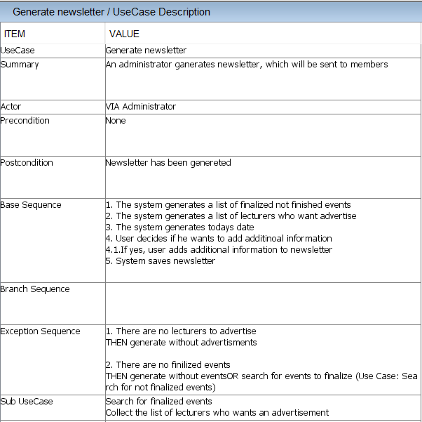

Slide 21



Non-functional requirements
The system must be implemented in Java
Secondary storage needs to be done with files (Event/Lecturer/Memberlists, newsletter)
The parts of the system must be accessible among them

Slide 22
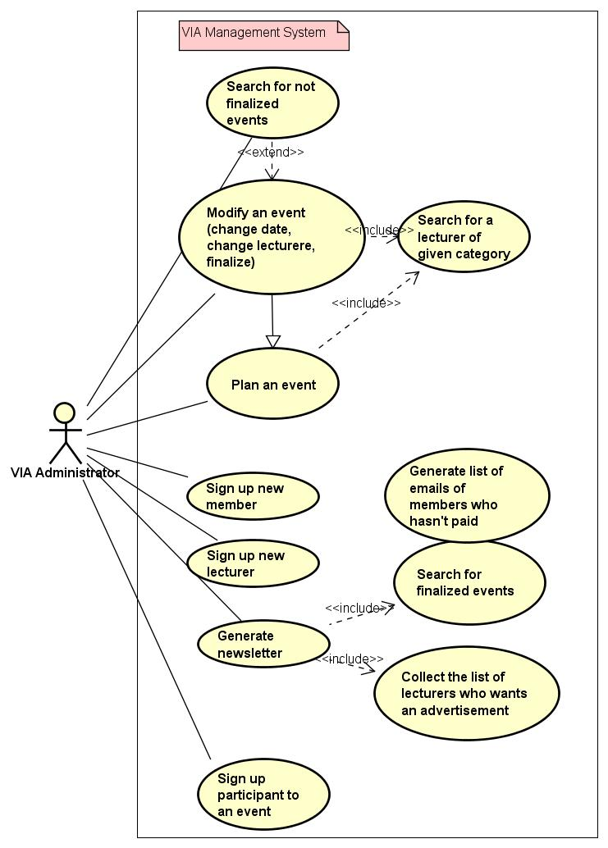
USE CASE DIAGRAM

Slide 23
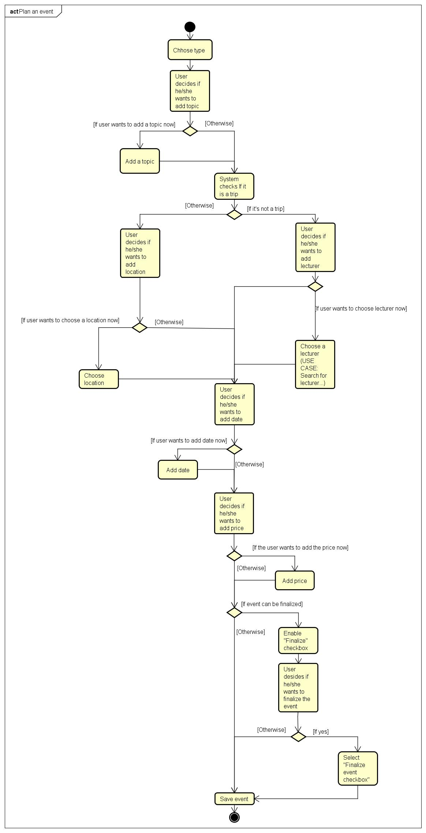
ACTIVITY DIAGRAM Create event

Slide 26
Design

Slide 27
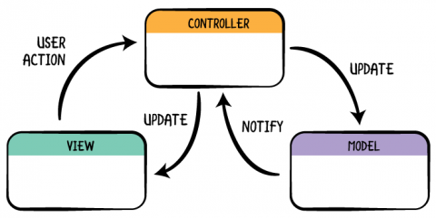
Model-view-controller

Slide 28
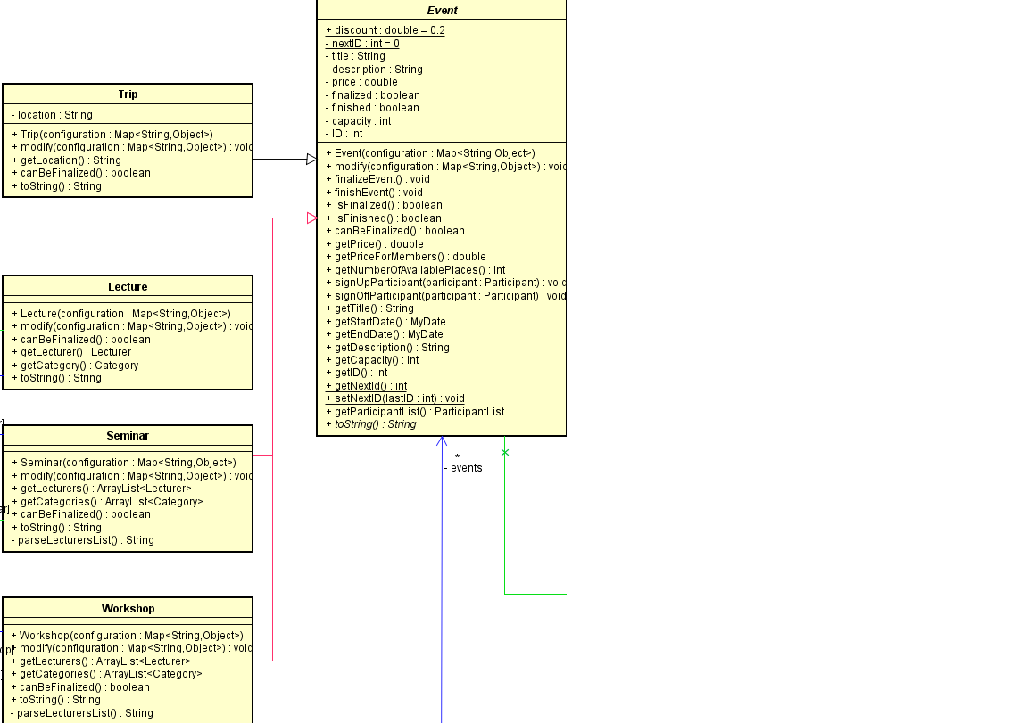
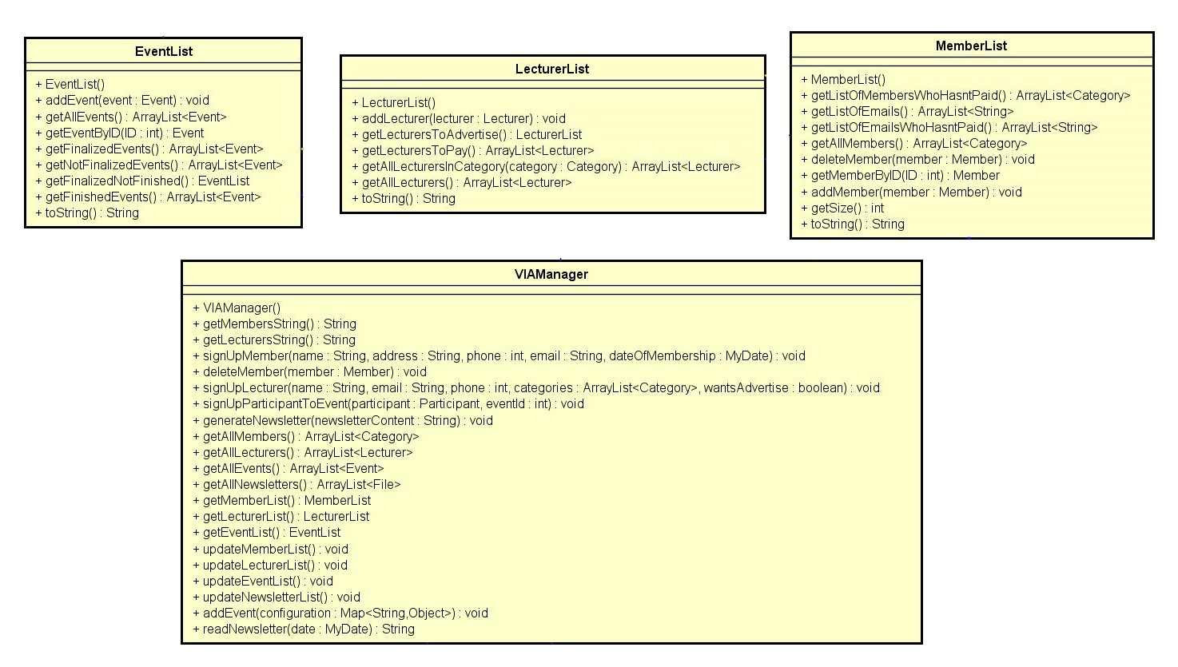
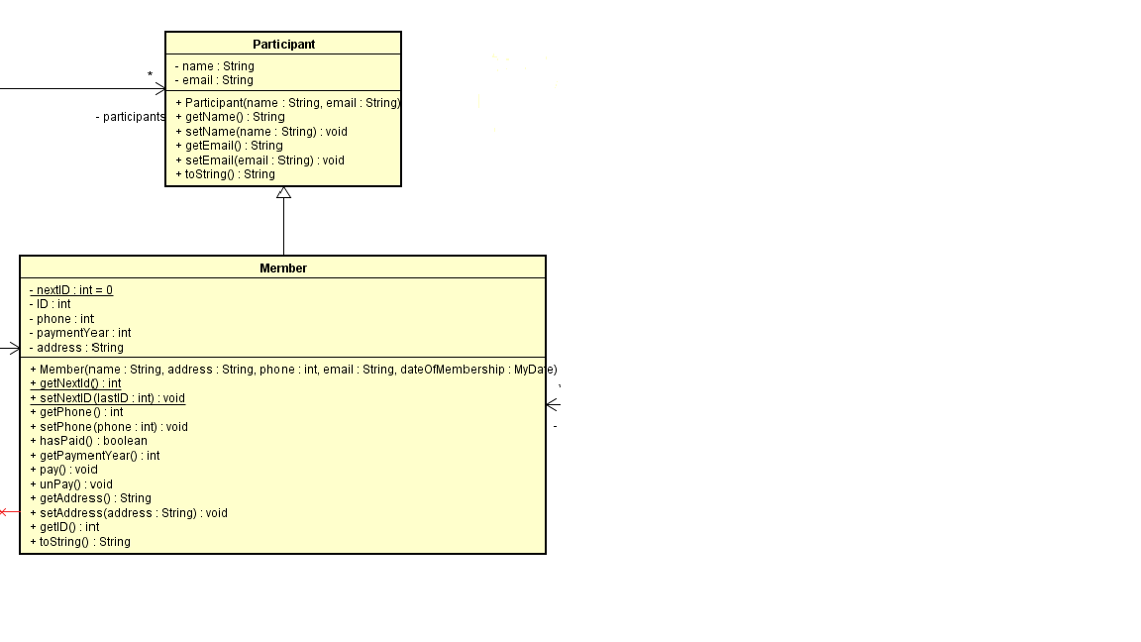
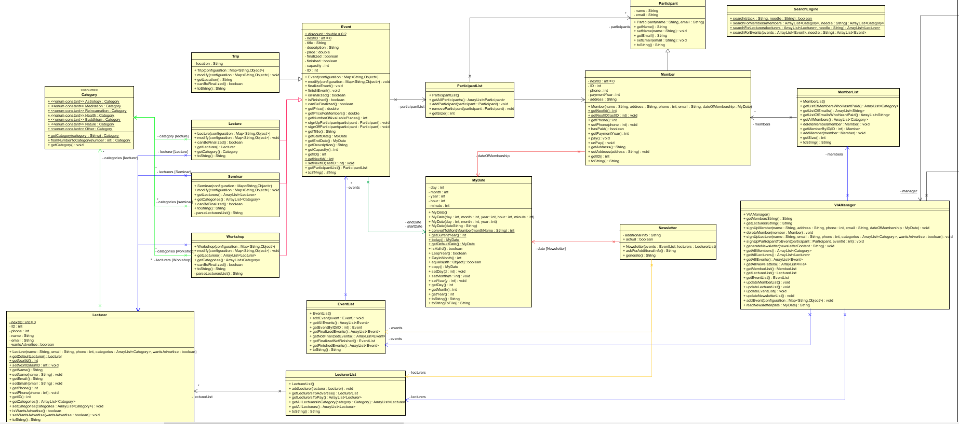
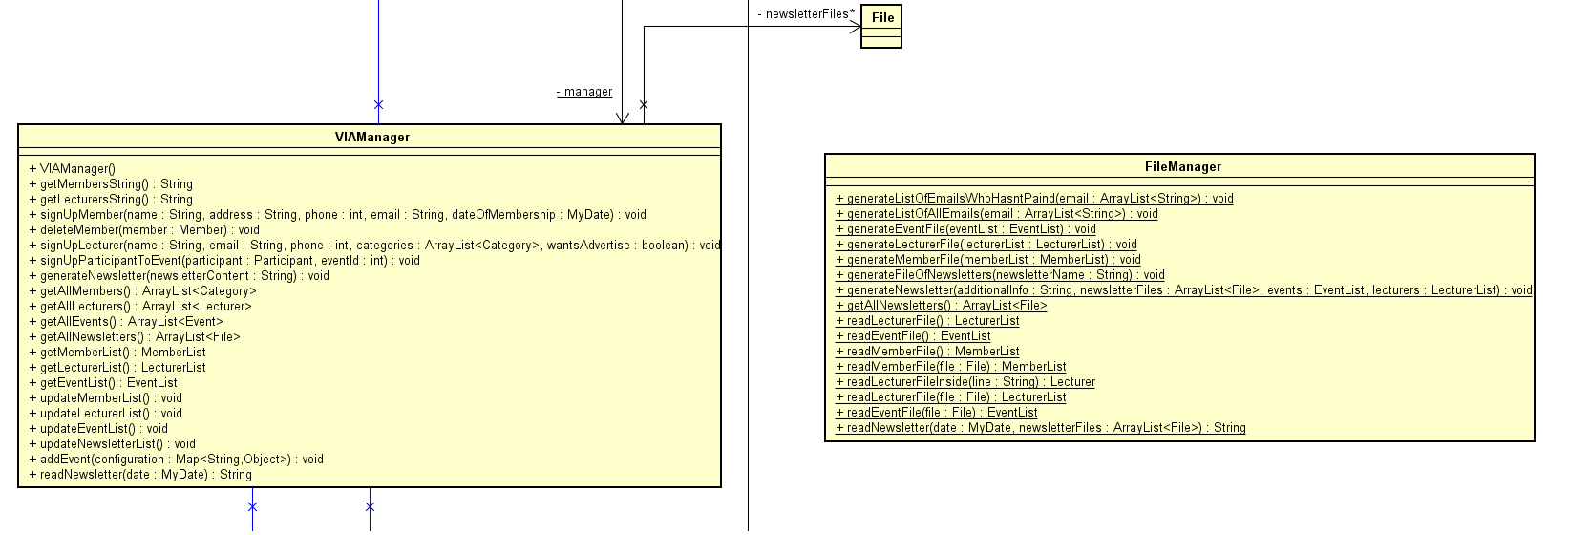
Model

Slide 29
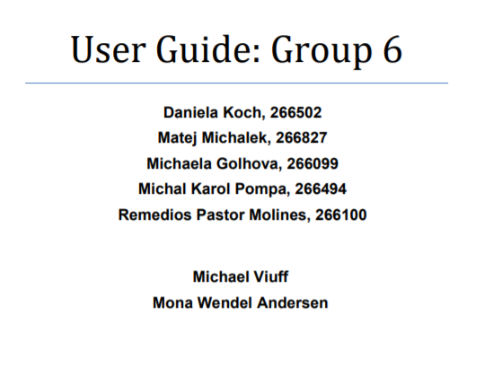
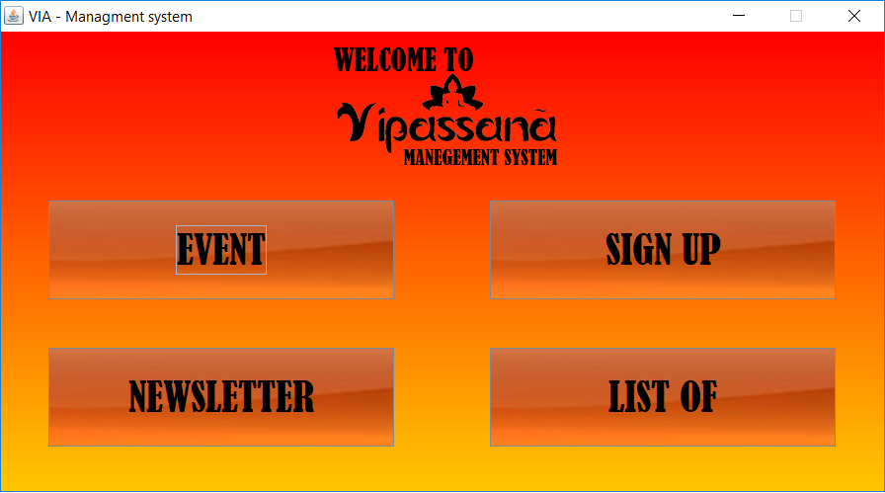
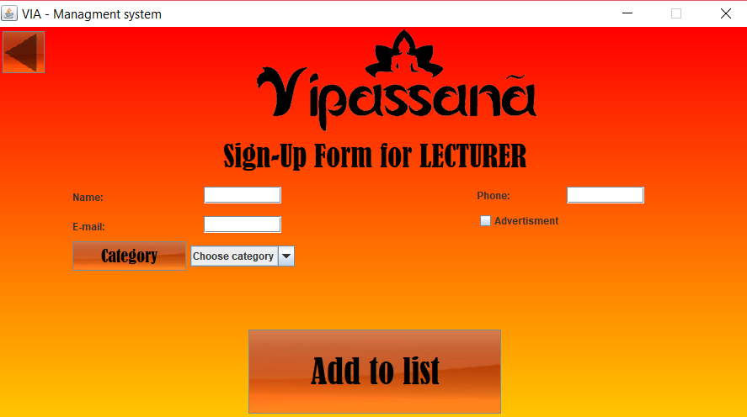
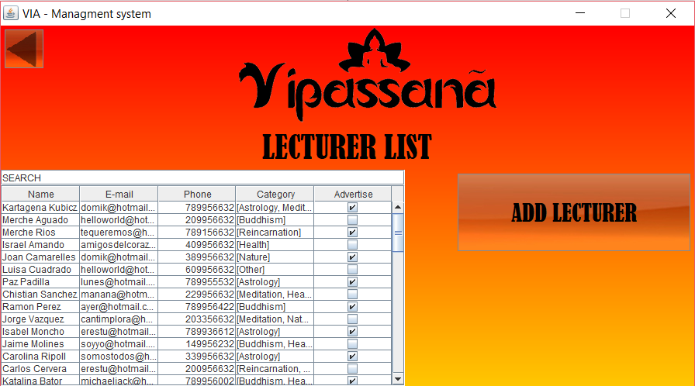
View

Slide 30
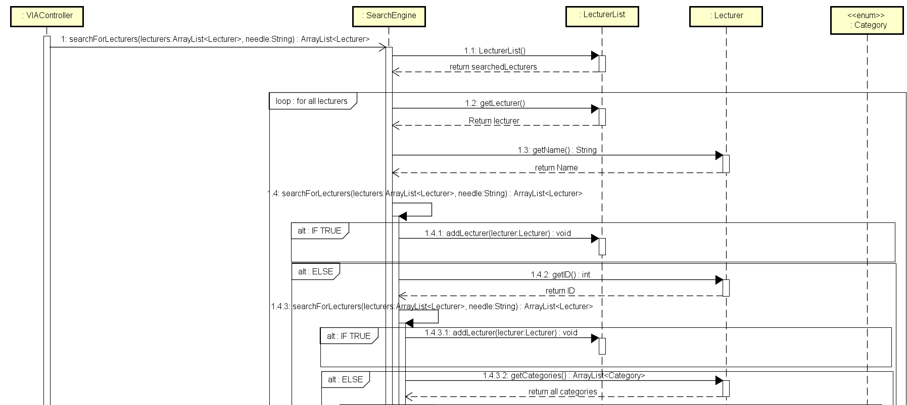
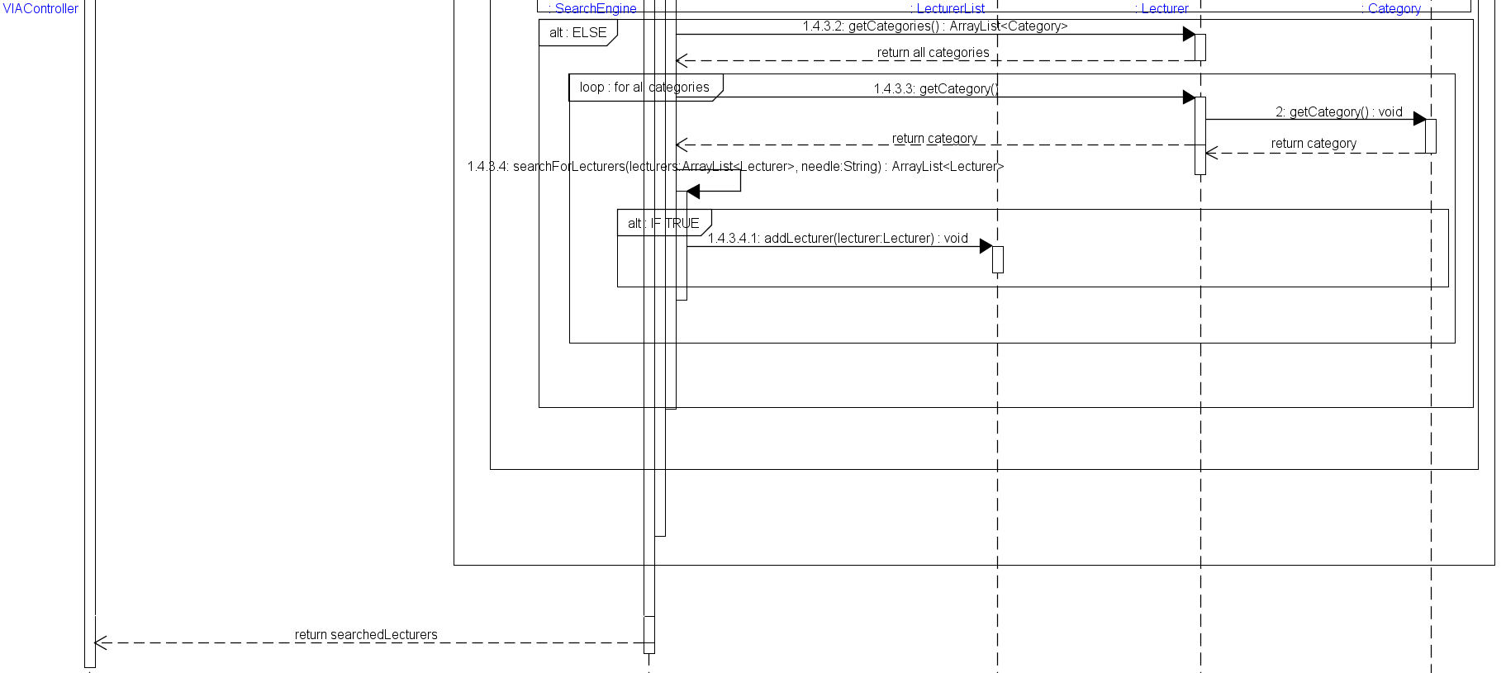
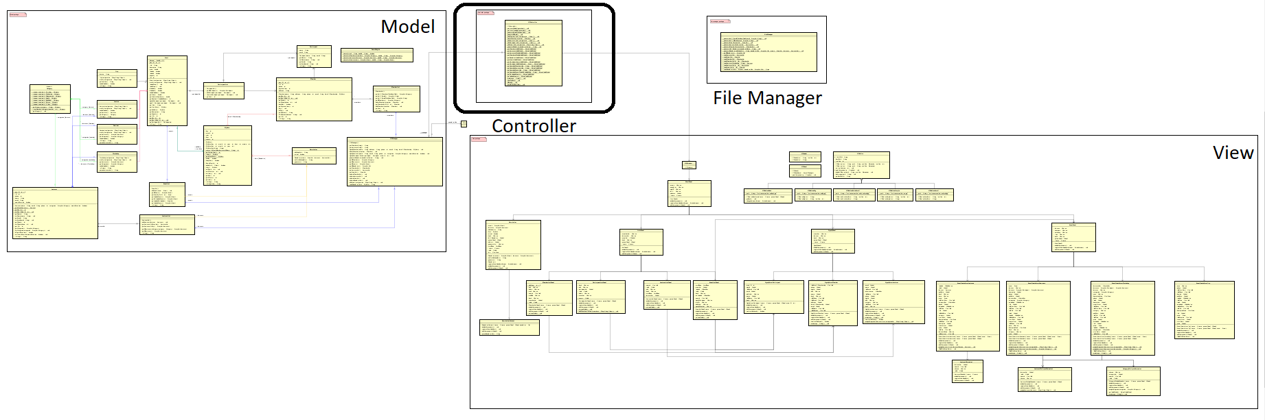
Controller

Slide 31
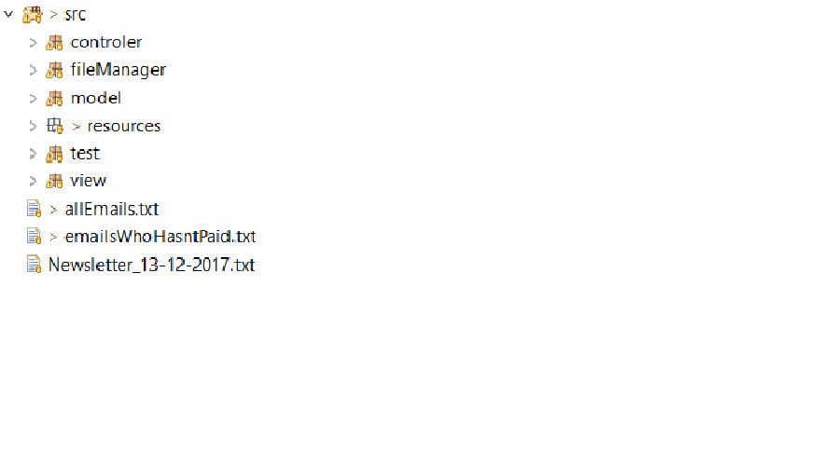

Organizing the code

Slide 32
Implementation

Slide 33
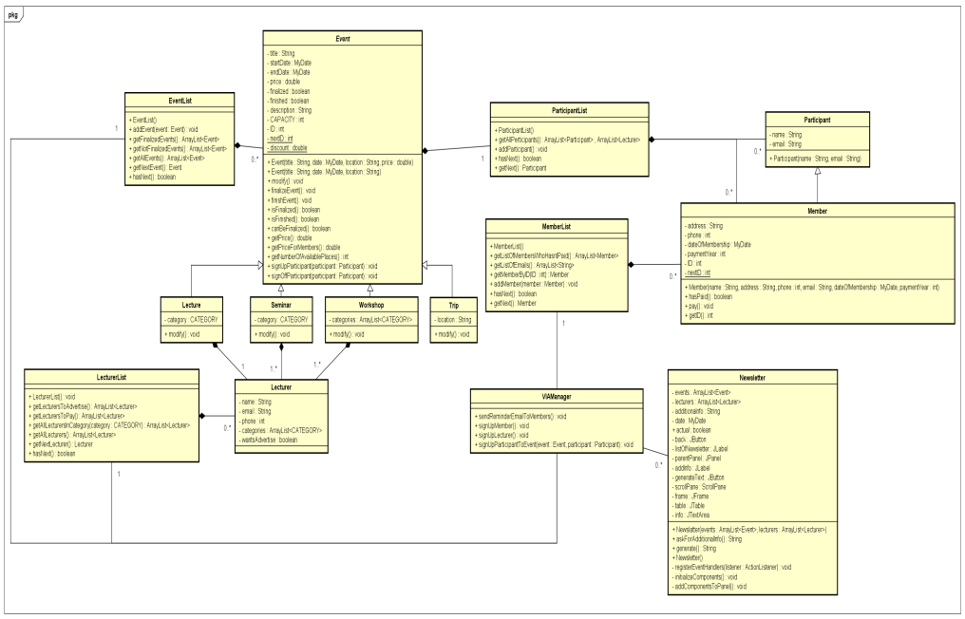
Work Methodology
GUI
MODEL

Slide 34
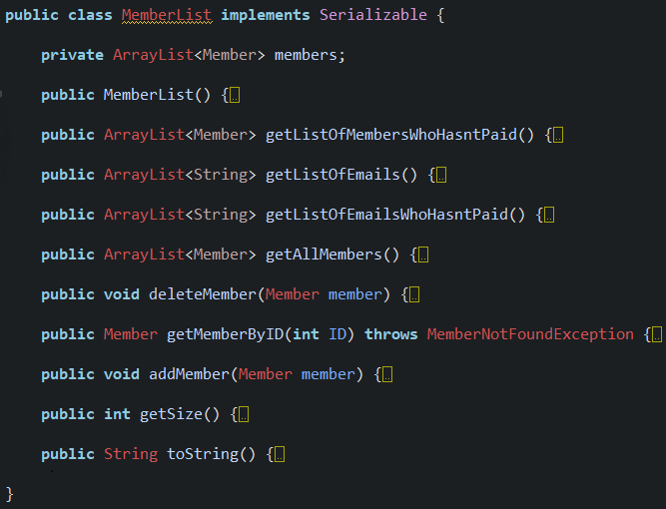
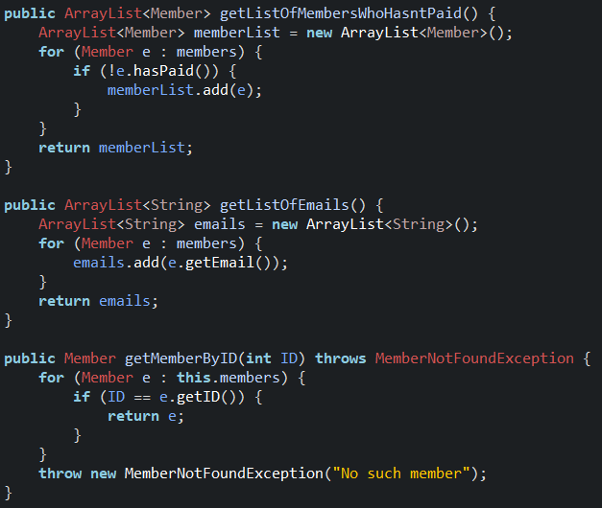
Class example – Member List

Slide 35
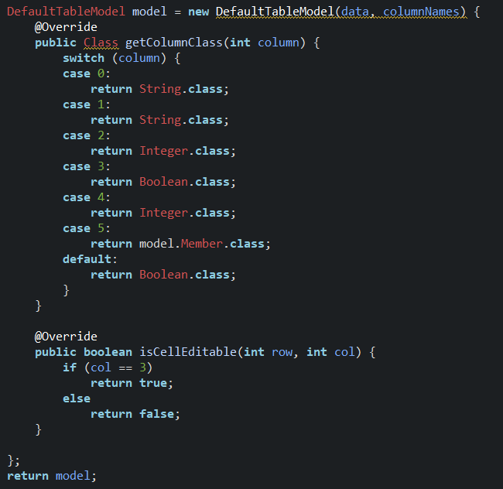
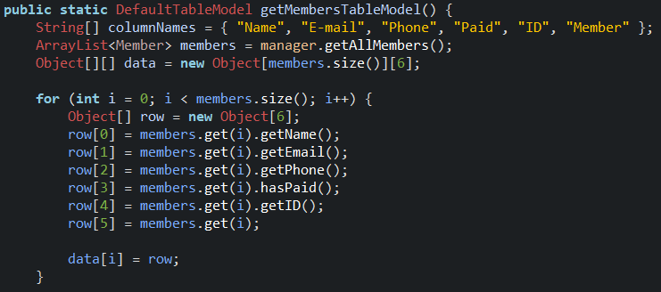
Controller - DefaultTableModel

Slide 36
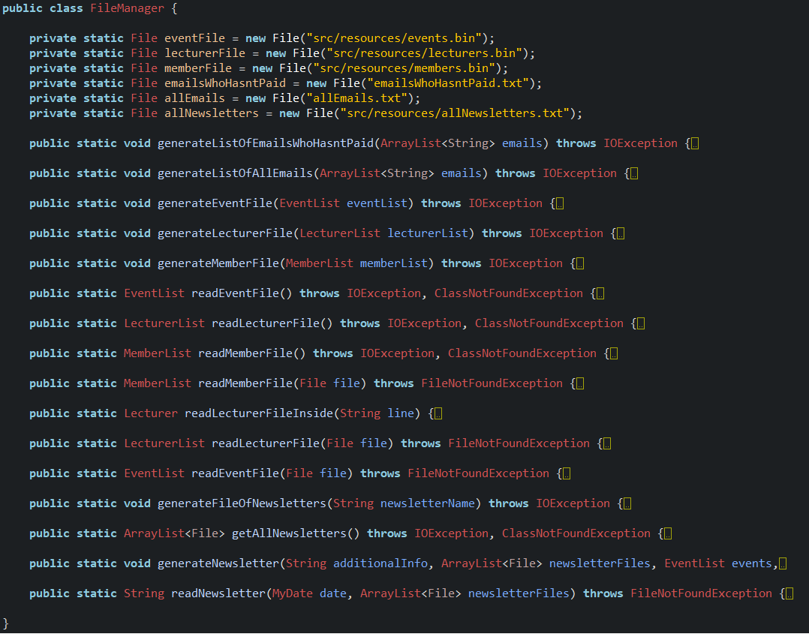
FileManager

Slide 37
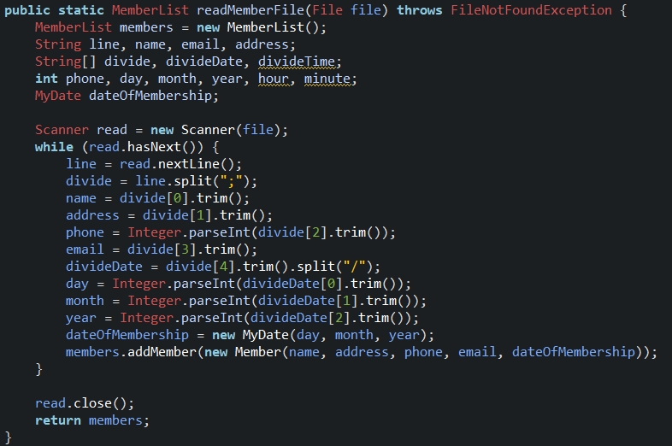
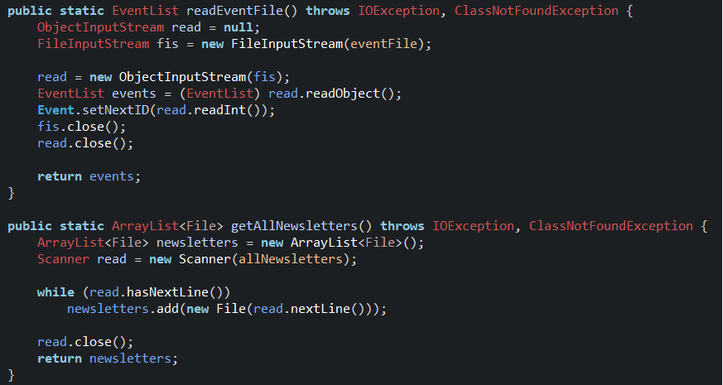
FileManager

Slide 38
Testing

Slide 39
Belbin roles, work methods, motivation

Slide 40
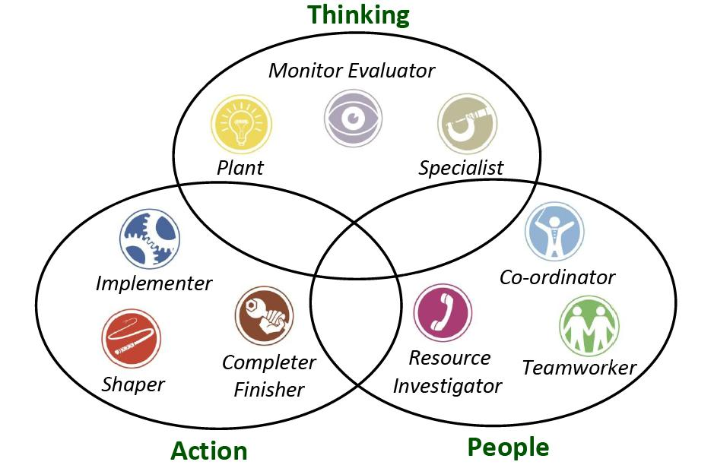

Slide 41
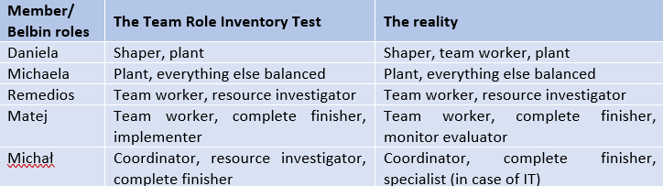
Belbin roles

Slide 42
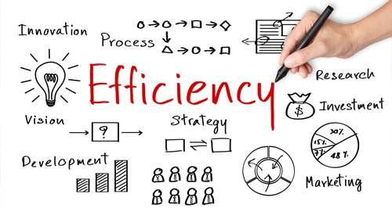
Work Methods
Gather ideas and formulate the main goals and overall structure together
Divide the work for groups consisting of 1-3 persons
Having everything checked by everyone

Slide 43



Using technical tools to help us working in group

Slide 44


Slide 45

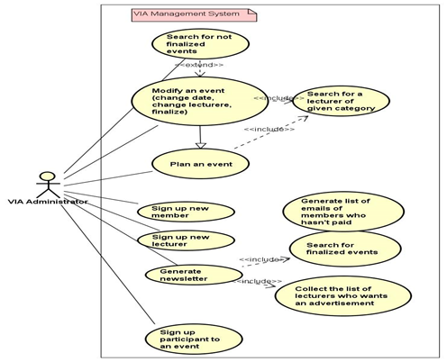
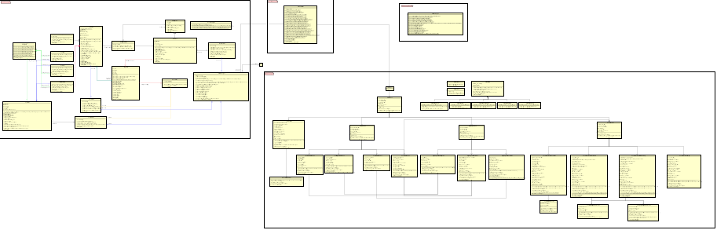
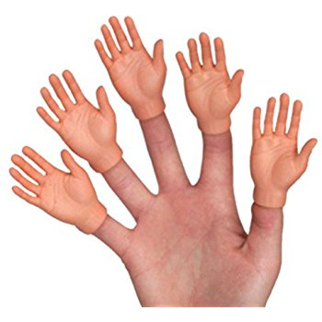
Conclusion (project report)

Slide 46





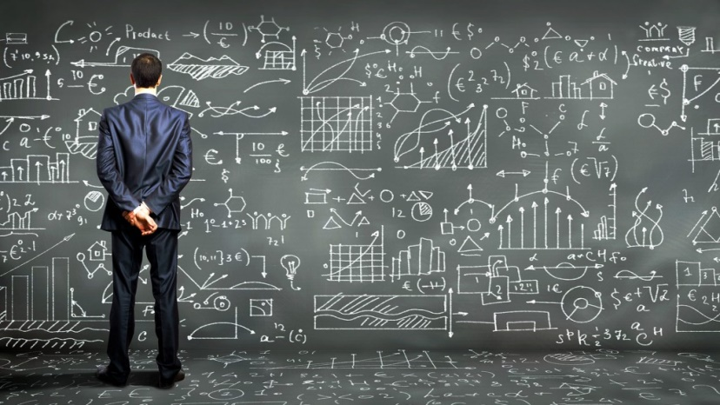

Conclusion (process report)

Slide 47



Future

